Slide 1
How does financial investment in healthcare-related areas influence life expectancy within the last 150 years globally?
Data Analysis Challenge
Olivia Peng & Angel Poi
Notes:
Hi, today we will be exploring the impact of financial healthcare investment on global life expectancy over the past 150 years.

Slide 2
Research Question
How does financial investment in healthcare-related areas influence life expectancy within the last 150 years globally?

Slide 3
Executive Summary
Personal
Impact of lifestyle factors
Linear regression test
Private
Impact of medical R&D investment
One-way ANOVA test
Public
Impact of government expenditures
Linear regression test
Notes:
We approached our research question from 3 factors; personal, private and public. For personal investment, we explored how obesity rates affect life expectancy upon conducting a linear regression test. For private investment, we underwent a one-way ANOVA test and determined the impact of medical R&D on life expectancy. We finally used linear regression to explore government expenditure on healthcare and education and its effect on life expectancy.

Slide 4
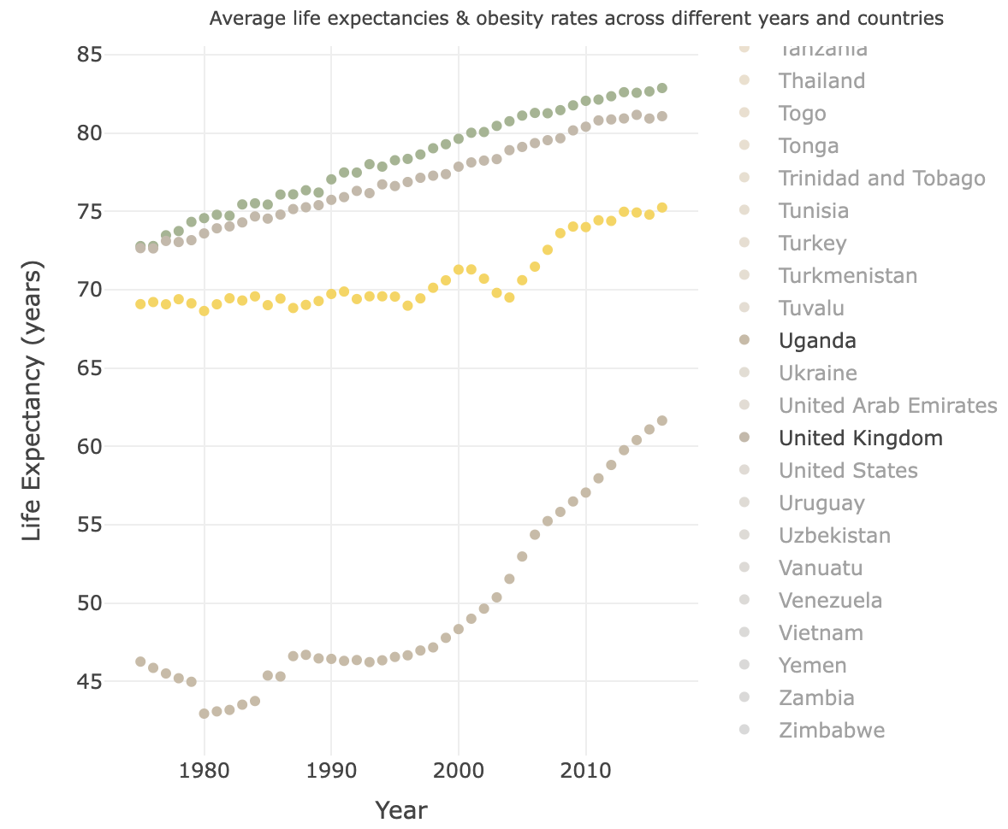
Personal investment and life expectancy
Linear regression test performed on relationship between obesity and life expectancy
P-value: p = 2.2 * 10⁻¹⁶
Statistical conclusion: reject the null
Scientific conclusion: high obesity rates leads to reduced life expectancy
Australia has one of the highest obesity rates but high life expectancy -> explained by advanced healthcare system
Notes:
The linear regression test performed gave an extremely small p-value to conclude a significant positive relationship between obesity and life expectancy, which is strongly refuted by scientific evidence. We observe how countries such as Australia (green line) has one of the highest obesity rates but also a high life expectancy with similar trends for the UK and US, despite studies showing that obesity causes anywhere between 5.6 to 10.3 years of lost life. This is potentially explained by the more advanced healthcare that are in place in developed countries to both prevent and manage the impacts of obesity. These countries likely receive more education surrounding the known negative effects of other lifestyle factors such as extreme tobacco and alcohol consumption in comparison to other developing countries such as Romania and Uganda which have significantly lower life expectancies as shown.

Slide 5
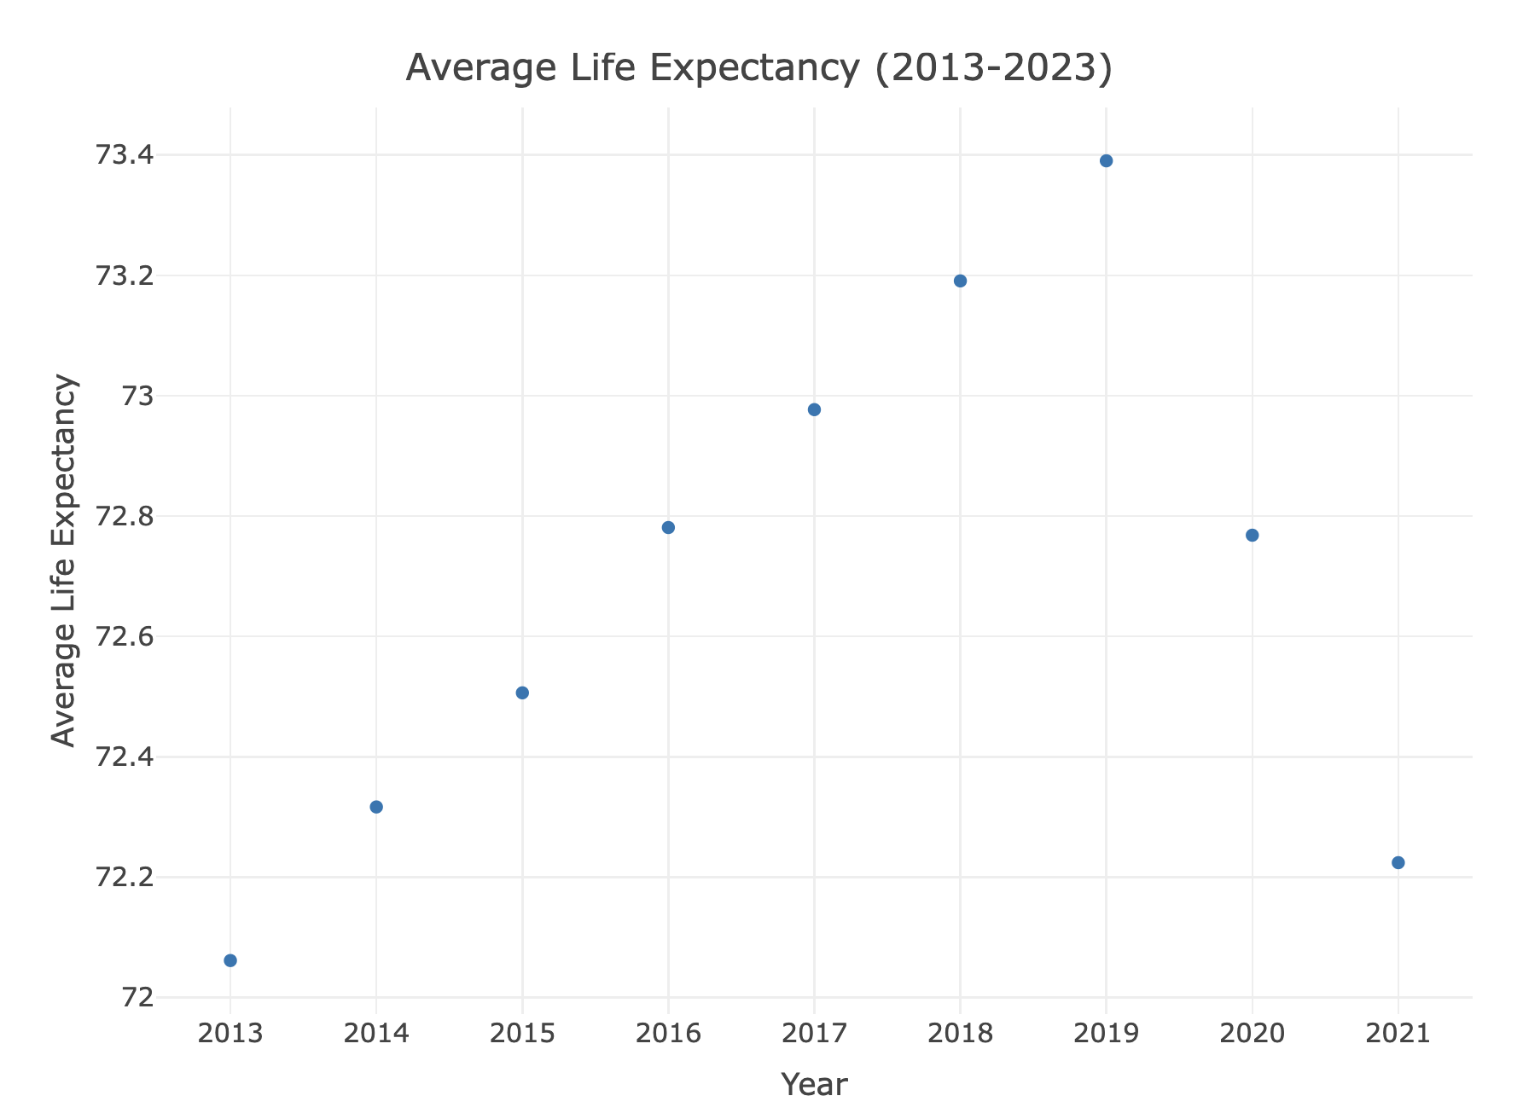
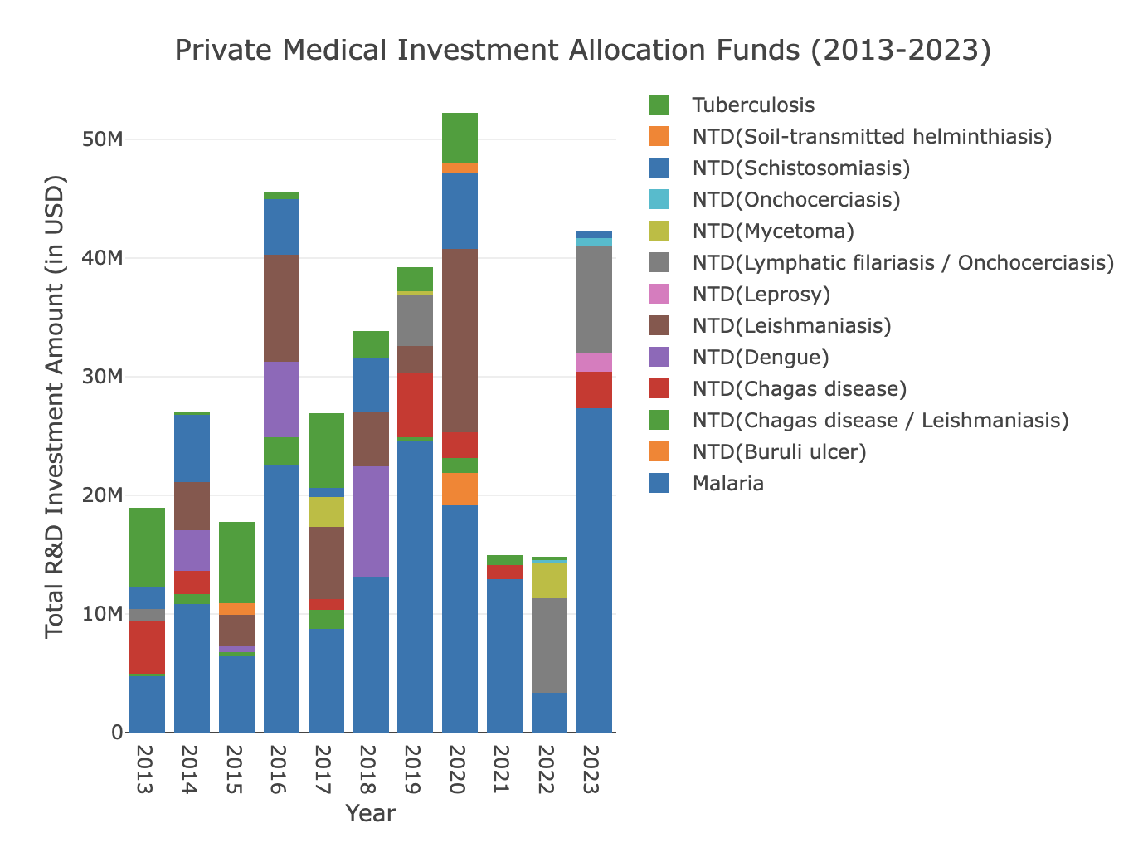
Private Medical R&D Investment Funds
& Average Life Expectancy (2013 - 2023)
ANOVA
2016
2013-2019
2020
p-value 0.051 > 0.05
H0 retained
R&D investment is long-term
Surge of 45M investment due to UN SDGs
Notable rise beyond 2016
Investment: 20M → 40M
Life expectancy: 72.06 → 73.39
Highest investment: over 50M
Lower life expectancy: 72.77
Notes:
We conducted a one-way ANOVA test to see whether life expectancy varies with medical research funding, finding a p-value of 0.051, which indicated no immediate effect. Given R&D's long-term impact, we further analyzed its effects.
From 2013 to 2019, investment grew by over $20M, with a 1.33-year increase in life expectancy. The 2016 surge of $45M likely influenced by the UN's 2015 Sustainable Development Goals correlates with a rise in life expectancy, suggesting that global initiatives and substantial investments yield long-term public health benefits.
In 2020, the highest investment of $50M coincided with a lower life expectancy of 72.77 years, likely due to the COVID pandemic. This reduction continued beyond 2020, indicating increased investments in other epidemic areas were insufficient to counteract COVID's negative impact on life expectancy.

Slide 6
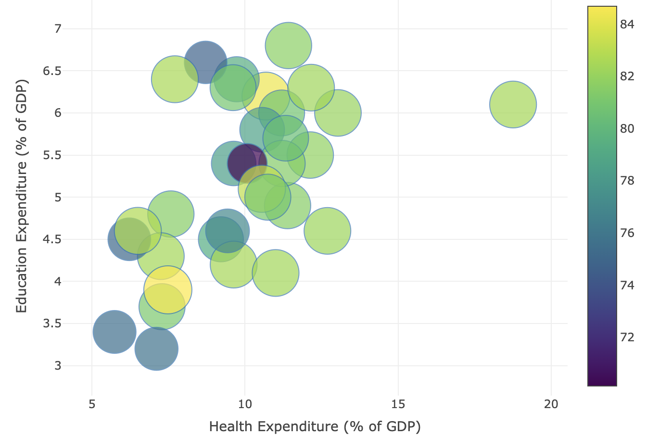
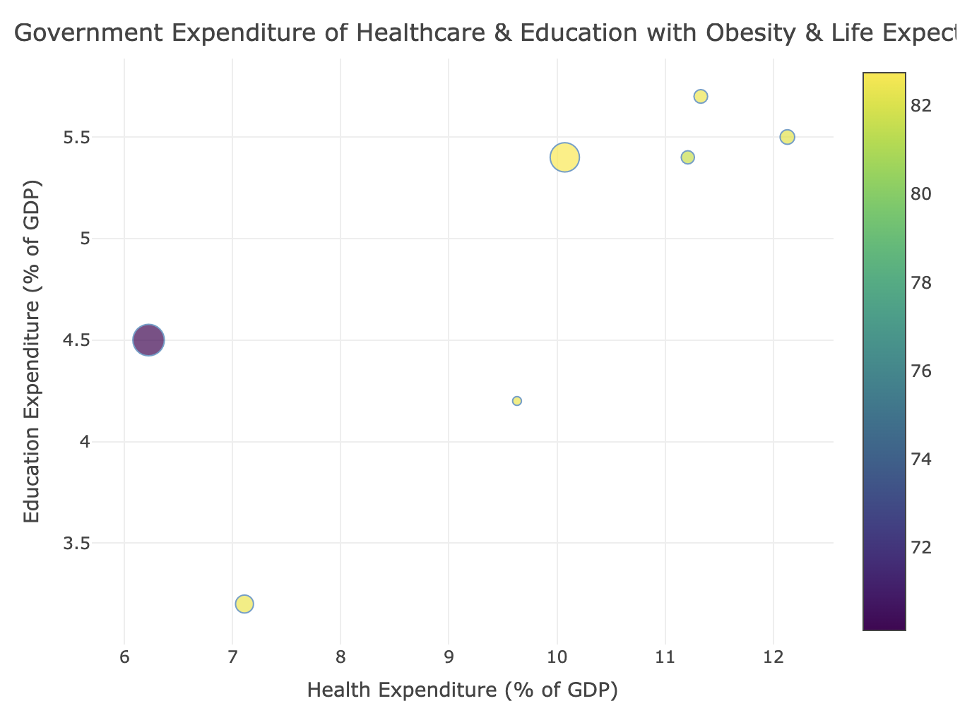
Government Expenditure on Healthcare & Education (2020)
Colour of points get lighter with increasing expenditure
Healthcare and education = more informed choices
Country with lowest investment into healthcare has lowest life expectancy
Increase of 1% government expenditure into healthcare leads to 0.008% increase in life expectancy
Notes:
Both graphs show a general positive relationship between health and education expenditure and an increasingly lighter gradient (corresponding to higher life expectancy) as both expenditures increase, evident in the second figure in particular.
As expected, the country that had the lowest spending on healthcare [in figure 2] also has the lowest life expectancy out of this sample, supported by scientific research that concluded for every 1% in government health expenditures, life expectancy improves by 0.008%. These observations are likely due to a more educated and healthier population being better informed and likely to make healthier lifestyle choices. The effect of substantial education and healthcare expenditure is also evident in the interpretation of obesity data where developed countries can both prevent and overcome health issues like obesity and increase awareness surrounding tobacco and alcohol consumption, pursuing higher life expectancy.

Slide 7
THANK YOU!

